Slide 1
Chapter 7
Digital Design and Computer Architecture, 2nd Edition
David Money Harris and Sarah L. Harris

Slide 2
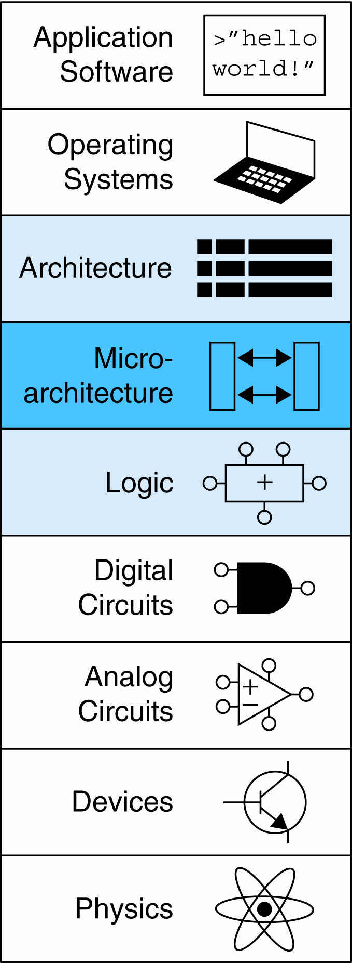
Chapter 7 :: Topics
Introduction
Performance Analysis
Single-Cycle Processor
Multicycle Processor
Pipelined Processor

Slide 3
Introduction
Microarchitecture: the specific arrangement of registers, ALUs, finite state machines (FSMs), memories, and other logic building blocks needed to implement an architecture.

Slide 4
Introduction
Design Process:
Datapath: operates on words of data. It contains structures such as memories, registers, ALUs, and multiplexers
Control: receives the current instruction from the datapath and tells the datapath how to execute that instruction. It produces multiplexer select, register enable, and memory write signals to control the operation of the datapath

Slide 5
Microarchitecture
Multiple implementations for a single architecture:
Single-cycle: Each instruction executes in a single cycle
Multicycle: Each instruction is broken into series of shorter steps
Pipelined: Each instruction broken up into series of steps & multiple instructions execute at once

Slide 6
Processor Performance
Program execution time
Execution Time = (#instructions)(cycles/instruction) (seconds/cycle)
Definitions:
CPI: The number of cycles per instruction is the number of clock cycles required to execute an average instruction
CPI: Cycles/instruction
IPC: instructions/cycle = IPC
Clock period: The number of seconds per cycle is the clock period T_{c}
T_{c} = seconds/cycle
Challenge is to satisfy constraints of:
Cost
Power
Performance

Slide 7
MIPS Processor
Consider subset of MIPS instructions:
R-type instructions: and, or, add, sub, slt
Memory instructions: lw, sw
Branch instructions: beq
lw: load word, to read a data word from memory into a register, it specifies the effective address in memory as the sum of a base address and an offset.
e.g., lw $s3, 1($0)
The base address is $0, which holds the value 0, and the offset is 1, so the lw instruction reads from memory address ($0 + 1) = 1.
After the lw instruction is executed, $s3 holds the data value stored at memory address 1.

Slide 8
MIPS Processor
Consider subset of MIPS instructions:
R-type instructions: and, or, add, sub, slt
Memory instructions: lw, sw
Branch instructions: beq
beq: branch if equal, braches when the values in two registers are equal
sw: store word, to write a data word from a register to a memory
e.g., sw $s7, 5($0)
writes the contents of register $7 into memory word 5

Slide 9
Architectural State
Determines everything about a processor:
Program Counter
Instruction Memory
Register file
Data memory

Slide 10
MIPS State Elements
Program counter: its output PC points to the current instruction; its input PC’ indicates the address of the next instruction.
Instruction Memory: takes a 32-bit instruction address input, A, and reads the 32-bit data (i.e., instruction) from that address onto the read data output, RD.

Slide 11
MIPS State Elements
Register file: two read ports specify as source operands, they read the 32-bit register values onto read data output RD1 and RD2. The write port takes a 5-bit address input, A3; a 32-bit write data input WD. A write enable input WE3; and a clock
Data memory: if the write enable WE is 1, it writes data WD into address A on the rising edge of the clock. If the write enable WE is 0, it reads address A onto RD.

Slide 12
Single-Cycle MIPS Processor
Executes an entire instruction in one cycle
Datapath
Control

Slide 13
Single-Cycle Datapath: lw fetch
STEP 1: Fetch instruction from memory
PC register contains the address of the instruction to execute.
The first step is to read this instruction from instruction memory.
The instruction memory reads out, or fetches, the 32-bit instruction, labeled Instr
lw $t2, 32($0)

Slide 14
Single-Cycle Datapath: lw Register Read
STEP 2: Read source operands from register file
The next step is to read the source register containing the base address. This register is specified in the rs field of the instruction, Instr_{25:21}.

Slide 15
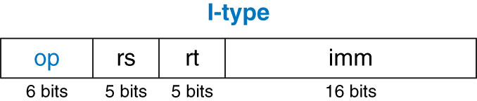
Single-Cycle Datapath: lw Register Read
STEP 2: Read source operands from register file
I-type instructions use two register operands and one immediate operand.
The 32-bit instruction has 4 fields: op, rs, rt, imm.
rs and imm are the source registers; rt is the destination for addi and lw instructions

Slide 16
Single-Cycle Datapath: lw Register Read
STEP 2: Read source operands from register file
The next step is to read the source register containing the base address. This register is specified in the rs field of the instruction, Instr_{25:21}.
lw $t2, 32($0)
rs = $0

Slide 17
Single-Cycle Datapath: lw Immediate
STEP 3: Sign-extend the immediate
The lw instruction requires an offset. The offset is stored in the immediate field of the instruction, Instr_{15:0}.
The 16-bit immediate might be either positive or negative, it must be sign-extended to 32 bits
SignImm_{15:0} = Instr_{15:0}; SignImm_{31:16} = Instr₁₅
lw $t2, 32($0)
rs = $0
SignImm_{15:0} = 32

Slide 18
Single-Cycle Datapath: lw address
STEP 4: Compute the memory address
The process must add the base address to the offset to find the address to read from memory.
ALUControl is set to 010 to add the base address and offset
ALUResult is sent to the data memory as the address for the load instruction
lw $t2, 32($0)
rs = $0
SignImm_{15:0} = 32
ALUResult = 0 + 32 = 32

Slide 19
Single-Cycle Datapath: lw Memory Read
STEP 5: Read data from memory and write it back to register file
The data is read from the data memory onto the ReadData bus, then written back to the destination register in the register file at the end of the cycle.
The destination register for the lw instruction is specified in the rt field, Instr_{20:16}, which is connected to the port 3 address input A3.
ReadData is connected to to WD3.
The write takes place on the rising edge of the clock

Slide 20
Single-Cycle Datapath: lw Memory Read
STEP 5: Read data from memory and write it back to register file
lw $t2, 32($0)
rs = $0
SignImm_{15:0} = 32
ALUResult = 0 + 32 = 32
rt = $t2
$t2 holds the data value stored at memory address 32

Slide 21
Single-Cycle Datapath: lw PC Increment
STEP 6: Determine address of next instruction
The process must compute the next instruction.
Instructions are 32 bits = 4 bytes, the next instruction is PC + 4.
The new address is written into the program counter on the next rising edge of the clock.

Slide 22
Single-Cycle Datapath: sw
sw instruction reads a second register from the register file and writes it to the data memory
The register is specified in the rt field, Instr_{20:16}.
The register value is read onto the RD2 port
MemWrite = 1 to write the data to memory

Slide 23
Single-Cycle Datapath: sw
ALUcontrol = 010, to add the base address and offset;
RegWrite = 0, nothing to be written to the register file
ReadData is ignored because RegWrite = 0

Slide 24
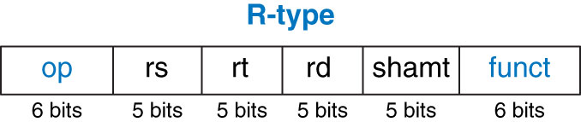
Single-Cycle Datapath: R-Type
R-type: register-type
R-type instructions use three registers as operands: two as sources, one as a destination.
The 32-bit instruction has 6 fields: op, rs, rt, rd, shamt and funct.
R-type instructions: add, sub, and, or and slt
e.g., add $s0, $s1, $s2
rs = $s1, rt = $s2, rd = $s0

Slide 25
Single-Cycle Datapath: R-Type
add rd, rs, rt
Read from rs (Instr_{25:21}) and rt (Instr_{20:16})

Slide 26
Single-Cycle Datapath: R-Type
Add a MUX to choose SrcB from either the register file RD2 port or SignImm
ALUSrc = 0 for R-type to choose SrcB from the register file; ALUSrc = 1 for lw and sw to choose SignImm

Slide 27
Single-Cycle Datapath: R-Type
Write ALUResult to the register file
Add a MUX to choose between ReadData and ALUResult, we call the output Result.
MemtoReg = 0 for R-type to choose Result from the ALUResult, MemtoReg = 1 for lw to choose ReadData

Slide 28
Single-Cycle Datapath: R-Type
For R-type instruction, the register to write is specified by the rd field, Instr_{15:11}
(for I-type instruction, the register to write is specified by the rt field, Instr_{20:16})
The MUX controlled by RegDst
RegDst= 1 for R-type to choose the rd field, Instr_{15:11};
RegDst = 0 for lw to choose the rt field, Instr_{20:16}

Slide 29
Single-Cycle Datapath: beq
beq $s0, $s1, target (if $s0 == $s1, jump to target)
If the values in rs and rt are equal, it takes the branch by adding the branch offset to the program counter
The offset is a positive or negative number, stored in the imm field of the instruction, Instr_{15:0}. The offset indicates the no. of instructions to branch past.

Slide 30
Single-Cycle Datapath: beq
The two registers are compared by computing SrcA – SrcB using the ALU.
If the ALUResult is 0, as indicated by the Zero flag from the ALU, the registers are equal.
Add a MUX to choose PC’ from either PCPlus4 or PCBranch
PCBranch is selected if the instruction is a branch and the Zero flag is asserted
Branch is 1 for beq, and 0 for others.

Slide 31
Single-Cycle Datapath: beq
The immediate must be sign-extended ad multiplied by 4 to get the new program counter
PC’ = PC + 4 + SignImm x 4
PCBranch is computed by shifting SignImm left by 2 bits, then adding it to PCPlus4.

Slide 32
Single-Cycle Processor

Slide 33
Single-Cycle Control

Slide 34
Review: ALU
F_{2:0} | Function
000 | A & B
001 | A | B
010 | A + B
011 | not used
100 | A & ~B
101 | A | ~B
110 | A - B
111 | SLT

Slide 35
Review: ALU

Slide 36
Control Unit: ALU Decoder
ALUOp_{1:0} | Meaning
00 | Add
01 | Subtract
10 | Look at Funct
11 | Not Used
ALUOp_{1:0} | Funct | ALUControl_{2:0}
00 | X | 010 (Add)
X1 | X | 110 (Subtract)
1X | 100000 (add) | 010 (Add)
1X | 100010 (sub) | 110 (Subtract)
1X | 100100 (and) | 000 (And)
1X | 100101 (or) | 001 (Or)
1X | 101010 (slt) | 111 (SLT)

Slide 37
Control Unit Main Decoder
Instruction | Op_{5:0} | RegWrite | RegDst | AluSrc | Branch | MemWrite | MemtoReg | ALUOp_{1:0}
R-type | 000000
lw | 100011
sw | 101011
beq | 000100

Slide 38
Control Unit: Main Decoder
Instruction | Op_{5:0} | RegWrite | RegDst | AluSrc | Branch | MemWrite | MemtoReg | ALUOp_{1:0}
R-type | 000000 | 1 | 1 | 0 | 0 | 0 | 0 | 10
lw | 100011 | 1 | 0 | 1 | 0 | 0 | 1 | 00
sw | 101011 | 0 | X | 1 | 0 | 1 | X | 00
beq | 000100 | 0 | X | 0 | 1 | 0 | X | 01

Slide 39
Single-Cycle Datapath: or

Slide 40
Extended Functionality: addi
No change to datapath

Slide 41
Control Unit: addi
Instruction | Op_{5:0} | RegWrite | RegDst | AluSrc | Branch | MemWrite | MemtoReg | ALUOp_{1:0}
R-type | 000000 | 1 | 1 | 0 | 0 | 0 | 0 | 10
lw | 100011 | 1 | 0 | 1 | 0 | 0 | 1 | 00
sw | 101011 | 0 | X | 1 | 0 | 1 | X | 00
beq | 000100 | 0 | X | 0 | 1 | 0 | X | 01
addi | 001000

Slide 42
Control Unit: addi
Instruction | Op_{5:0} | RegWrite | RegDst | AluSrc | Branch | MemWrite | MemtoReg | ALUOp_{1:0}
R-type | 000000 | 1 | 1 | 0 | 0 | 0 | 0 | 10
lw | 100011 | 1 | 0 | 1 | 0 | 0 | 1 | 00
sw | 101011 | 0 | X | 1 | 0 | 1 | X | 00
beq | 000100 | 0 | X | 0 | 1 | 0 | X | 01
addi | 001000 | 1 | 0 | 1 | 0 | 0 | 0 | 00

Slide 43
Extended Functionality: j

Slide 44
Control Unit: Main Decoder
Instruction | Op_{5:0} | RegWrite | RegDst | AluSrc | Branch | MemWrite | MemtoReg | ALUOp_{1:0} | Jump
R-type | 000000 | 1 | 1 | 0 | 0 | 0 | 0 | 10 | 0
lw | 100011 | 1 | 0 | 1 | 0 | 0 | 1 | 00 | 0
sw | 101011 | 0 | X | 1 | 0 | 1 | X | 00 | 0
beq | 000100 | 0 | X | 0 | 1 | 0 | X | 01 | 0
j | 000100

Slide 45
Control Unit: Main Decoder
Instruction | Op_{5:0} | RegWrite | RegDst | AluSrc | Branch | MemWrite | MemtoReg | ALUOp_{1:0} | Jump
R-type | 000000 | 1 | 1 | 0 | 0 | 0 | 0 | 10 | 0
lw | 100011 | 1 | 0 | 1 | 0 | 0 | 1 | 00 | 0
sw | 101011 | 0 | X | 1 | 0 | 1 | X | 00 | 0
beq | 000100 | 0 | X | 0 | 1 | 0 | X | 01 | 0
j | 000100 | 0 | X | X | X | 0 | X | XX | 1

Slide 46
Review: Processor Performance
Program Execution Time
= (#instructions)(cycles/instruction)(seconds/cycle)
= # instructions x CPI x T_{C}

Slide 47
Single-Cycle Performance
T_{C} limited by critical path (lw)
Other instructions have shorter critical paths
Each instruction in the single-cycle processor takes one clock cycle, so the CPI is 1

Slide 48
Single-Cycle Performance
Single-cycle critical path:
T_{c} = t_{pcq_PC} + t_{mem} + max(t_{RFread}, t_{sext} + t_{mux}) + t_{ALU} + t_{mem} + t_{mux} + t_{RFsetup}
Typically, the ALU, memory, and register file accesses are substantially slower than other operations, the cycle time simplifies to
T_{c} = t_{pcq_PC} + 2t_{mem} + t_{RFread} + t_{mux} + t_{ALU} + t_{RFsetup}
The clock period is constant and must be long enough to accommodate the slowest instruction

Slide 49
Single-Cycle Performance Example
Element | Parameter | Delay (ps)
Register clock-to-Q | t_{pcq_PC} | 30
Register setup | t_{setup} | 20
Multiplexer | t_{mux} | 25
ALU | t_{ALU} | 200
Memory read | t_{mem} | 250
Register file read | t_{RFread} | 150
Register file setup | t_{RFsetup} | 20
T_{c} = ?

Slide 50
Single-Cycle Performance Example
Element | Parameter | Delay (ps)
Register clock-to-Q | t_{pcq_PC} | 30
Register setup | t_{setup} | 20
Multiplexer | t_{mux} | 25
ALU | t_{ALU} | 200
Memory read | t_{mem} | 250
Register file read | t_{RFread} | 150
Register file setup | t_{RFsetup} | 20
T_{c} = t_{pcq_PC} + 2t_{mem} + t_{RFread} + t_{mux} + t_{ALU} + t_{RFsetup}
= [30 + 2(250) + 150 + 25 + 200 + 20] ps
= 925 ps

Slide 51
Single-Cycle Performance Example
Program with 100 billion instructions:
Execution Time = # instructions x CPI x T_{C}
= (100 × 10⁹)(1)(925 × 10⁻¹² s)
= 92.5 seconds
A picosecond (ps) is 10⁻¹² of a second
A nanosecond (ns) is 10⁻⁹ of a second
A microsecond (µs) is 10⁻⁶ of a second
A millisecond (ms) is 10⁻³ of a second

